Slide 1

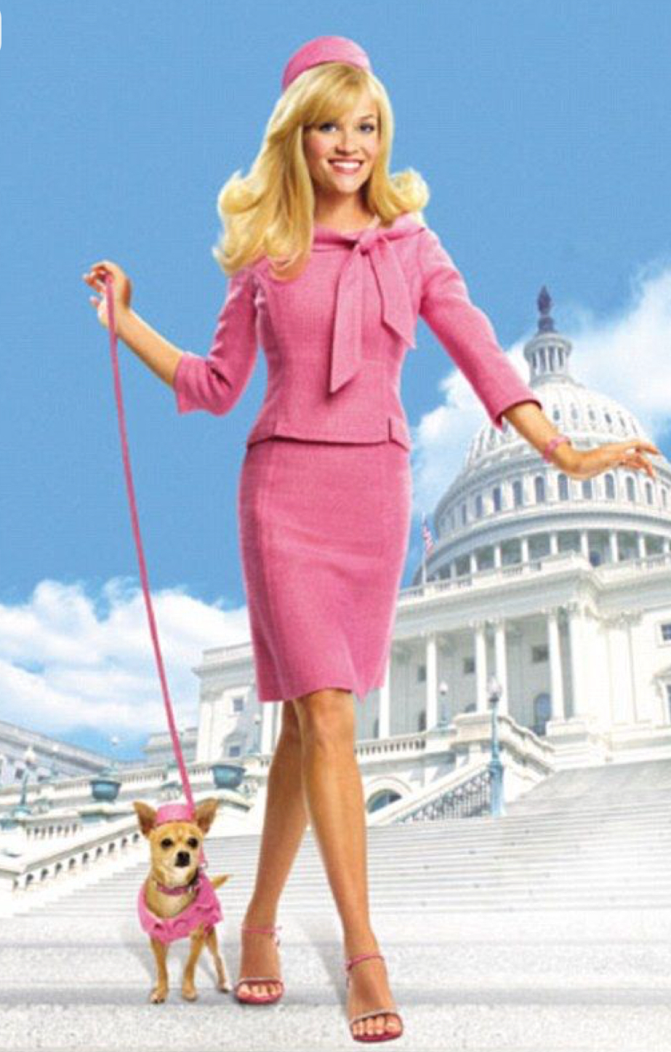
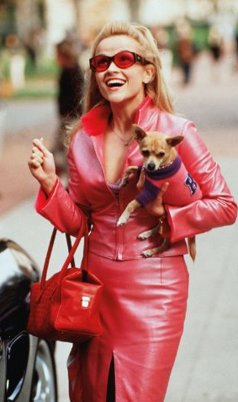
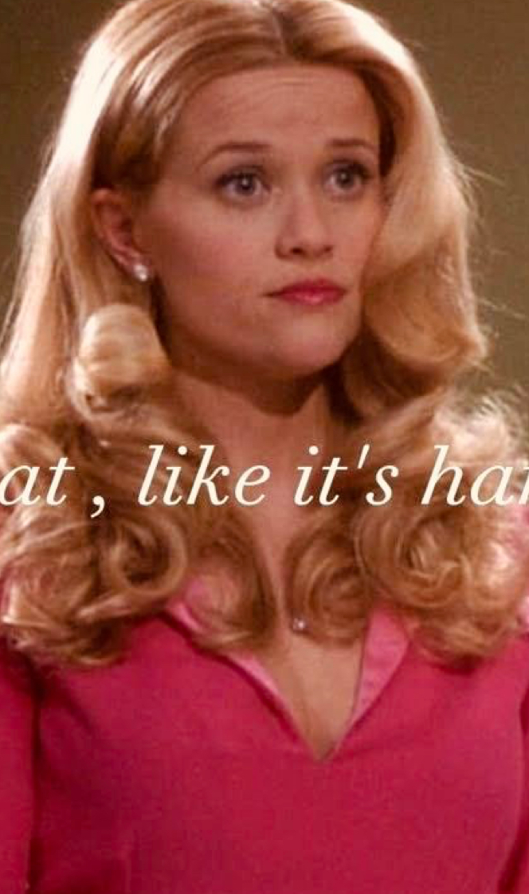
The Era of Intentional Femininity
Konstantina & Hanna
The upcoming Elle series, a prequel to the iconic Legally Blonde franchise, directly connects to the current zeitgeist and will reawaken the values that made Elle Woods a symbol of empowerment. Known for her playful pink style and sharp intellect, Elle proved that femininity and ambition can coexist. This revival will spark a fashion movement in FW26 of intentional femininity, blending soft, girlish aesthetics with structure and confidence, where tailored pieces, polished details, and a touch of pink redefine what power and professionalism look like.

Slide 2
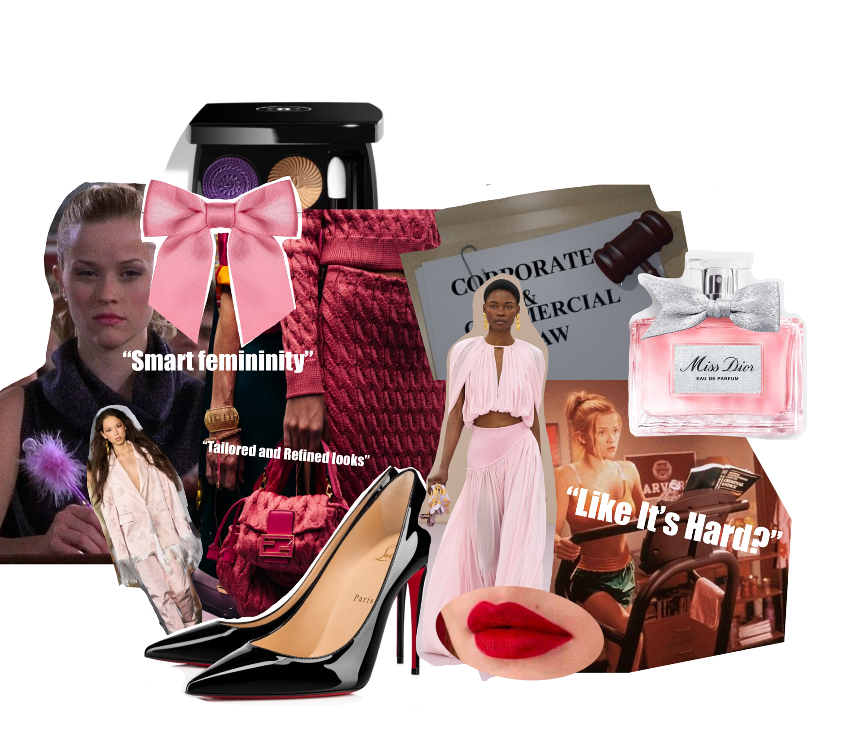
"Elle Effect” in Fashion
The current zeitgeist of empowered authenticity, combined with the Elle effect, will inspire fashion that is both girly and refined. Chic, tailored designs will blend softness with structure, redefining femininity as intelligent, confident, and sophisticated.
Konstantina & Hanna

Slide 3
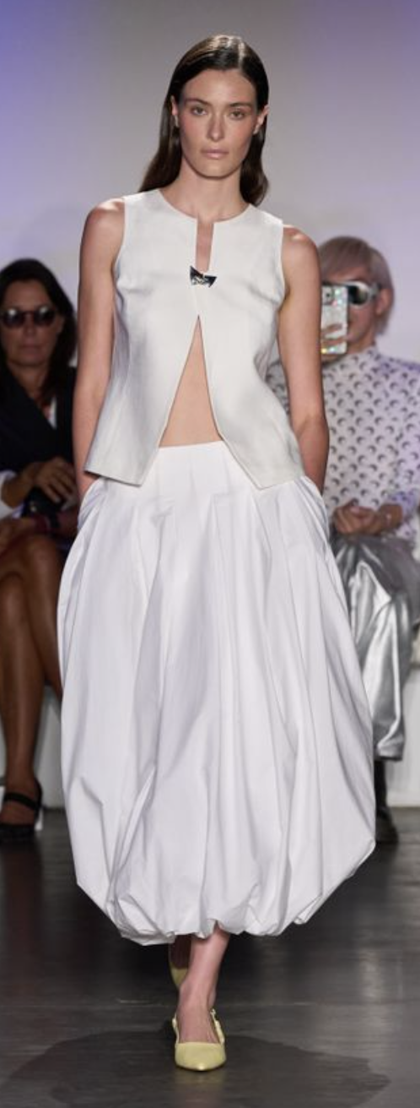
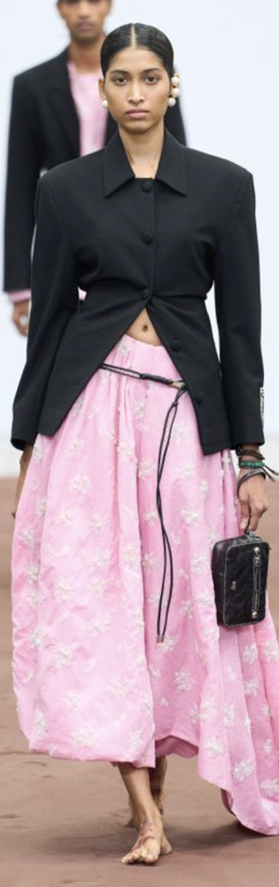
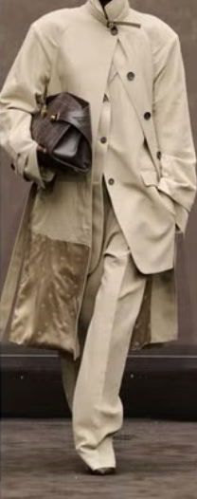
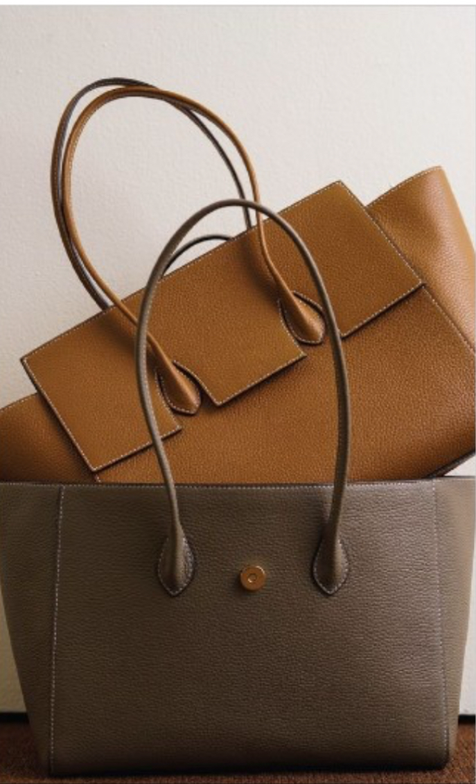
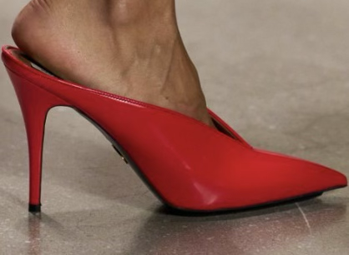
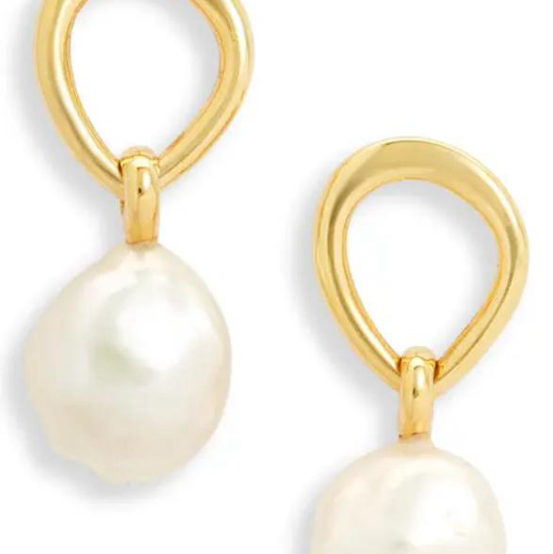
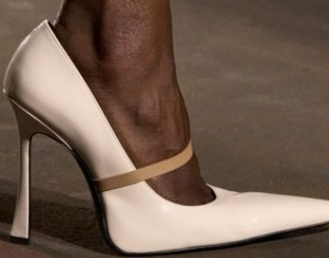
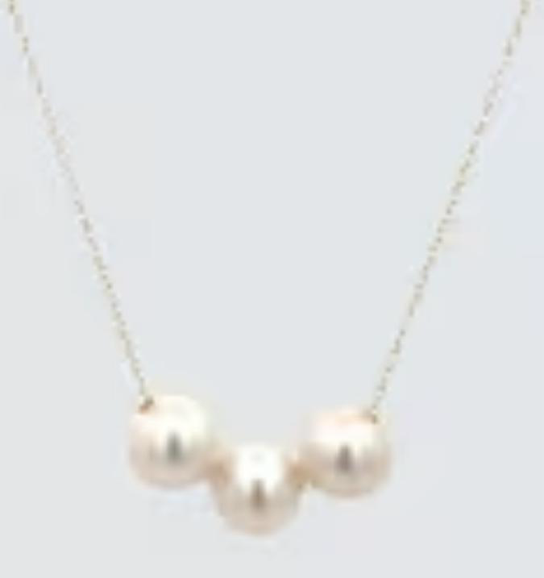
“Elle effect” translated in design and products
Konstantina & Hanna
Garments:
Tailored Blazers/Coats
Skirts with draping
Wide leg trousers
1.
2.
4.
3.
4.
Accessories:
Leather Structured Bags
High Heels
Pearls/refined jewelry
Future Snoops, Rounn, SS26
Future Snoops, Mugler, SS26
Future Snoops, Stella McCartney, SS26
Future Snoops, Oct 25, Nordstrorm, SS26
1.
2.
3.
Hyper-femininity with strength
Polished yet playful style
Empowered elegance
"Intellectual Chic"
Soft Power
Brains, beauty, and boldness
1.Bazaar, September 18th 2025, FW26 Junya Watanabe
2.Future Snoops, Oct 5th 2025, FW26 Dhruv Kapoor
3.Bazaar, September 18th 2025, FW26

Slide 4
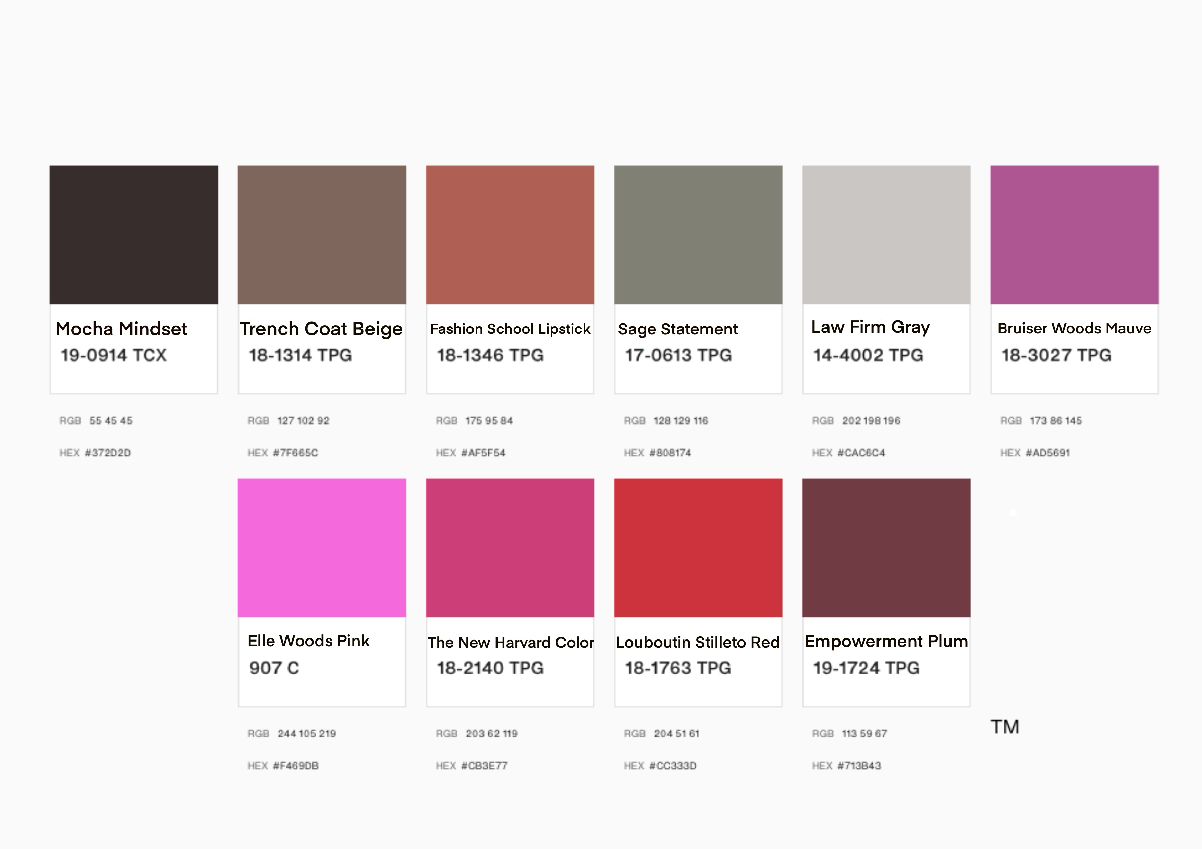
Konstantina
"Elle Effect” in Color for FW26

Slide 5
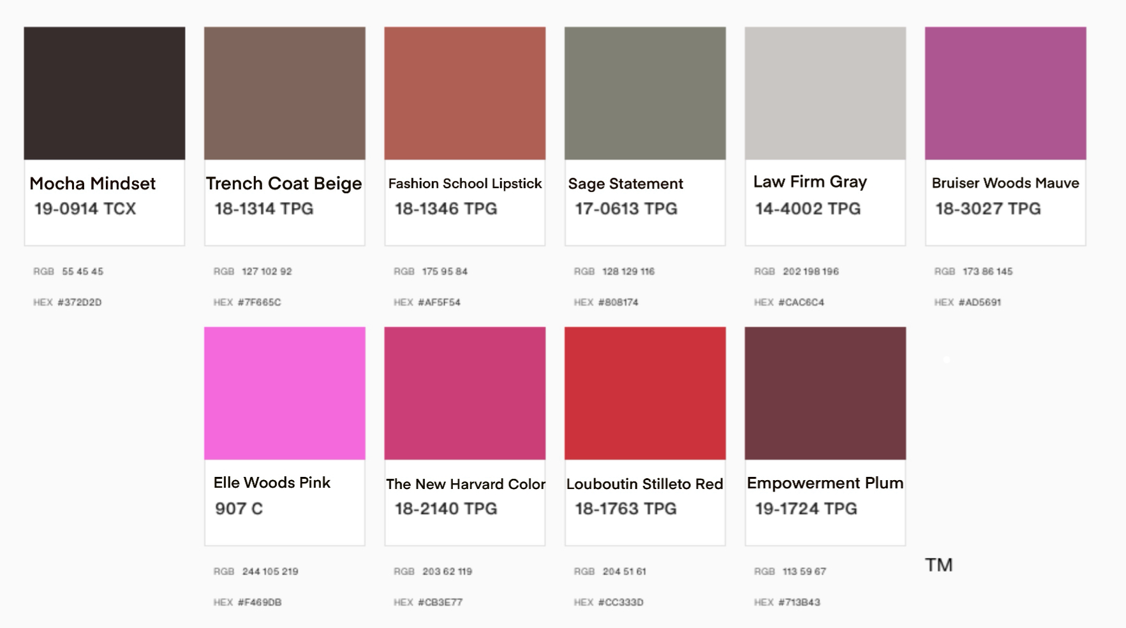
"Elle Effect” in Sample Forecast
Konstantina
The “Elle Effect” palette is inspired by the revival of confident femininity , a blend of intellect, elegance, and self-expression. From the pinks that capture Elle Woods’ charm to the sophisticated neutrals that reflect her ambition, this palette celebrates strength through softness. These hues evoke the journey of modern womanhood which is a bold yet balanced, playful yet powerful that prove that femininity and intelligence coexist beautifully.
Mocha Mindset
A deep espresso brown symbolizing grounded strength and sophistication , the foundation of self-assured elegance.
Trench Coat Beige
A classic neutral inspired by timeless outerwear, representing practicality and understated confidence.
Fashion School Lipstick
A muted red-coral that channels creativity and charisma, being the color of ambition in motion.
Sage Statement
A soft, balanced green symbolizing wisdom and calm focus, the thoughtful side of power.
Law Firm Gray
A refined silver-gray that captures professionalism, intellect, and resilience in a modern feminine form.
Bruiser Woods Mauve
A lively mauve tone representing loyalty and charm, like Elle’s iconic pink pup and playful spirit.
Elle Woods Pink
The signature hue of confident femininity which is bold, radiant, and joyfully self-expressive.
The New Harvard Color
A sophisticated pink-red, merging intellect and passion, a reimagined symbol of academic empowerment.
Louboutin Stiletto Red
A fiery, high-intensity red evoking power, allure, and unapologetic ambition.
Empowerment Plum
A rich, deep plum with emotional depth, embodying transformation, inner strength, and self-mastery.
Color Palette

Slide 6
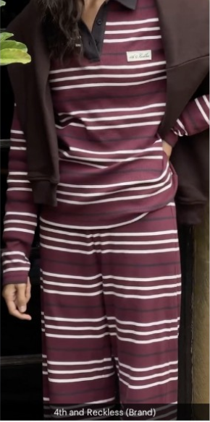
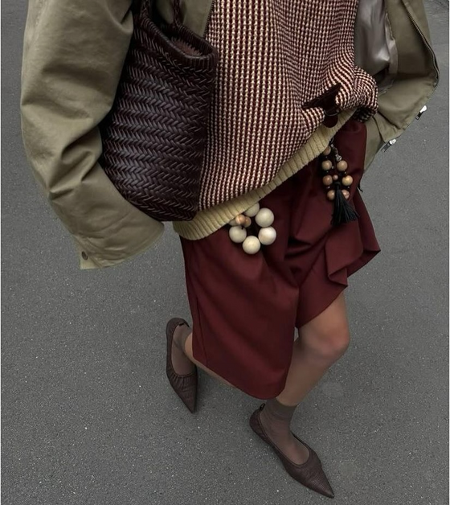
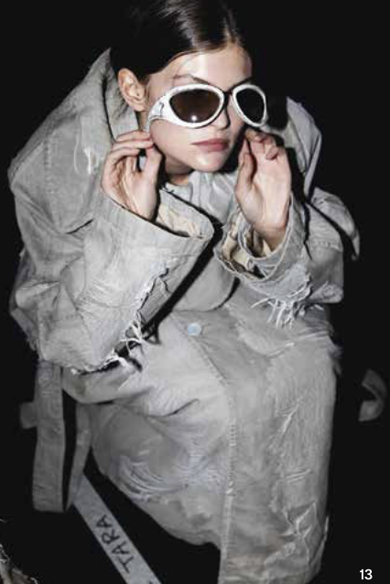
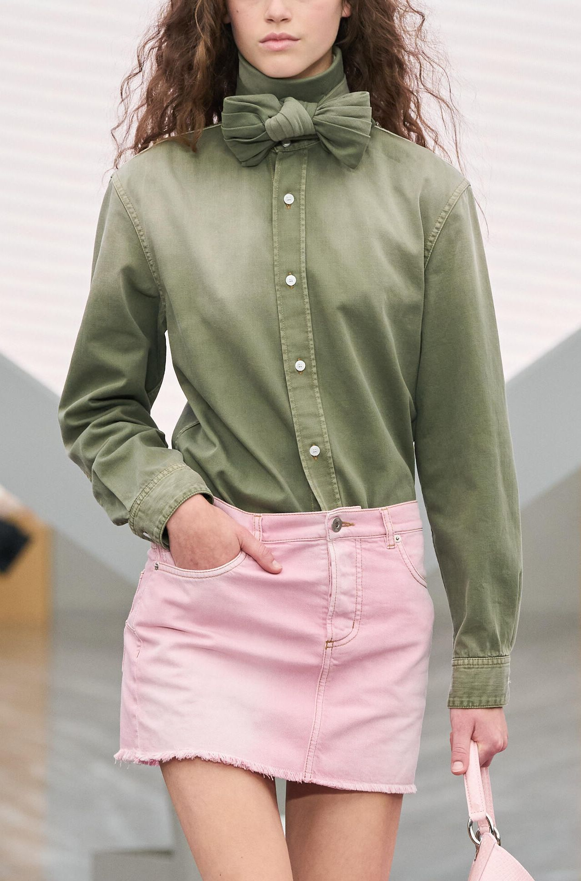
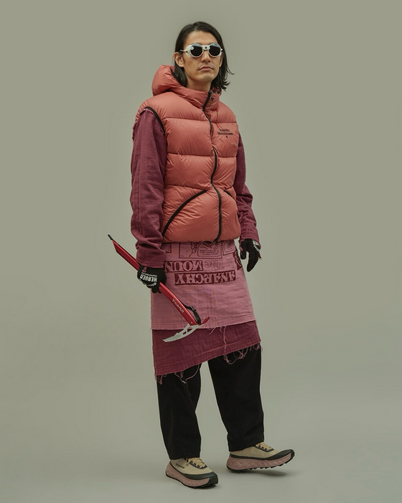
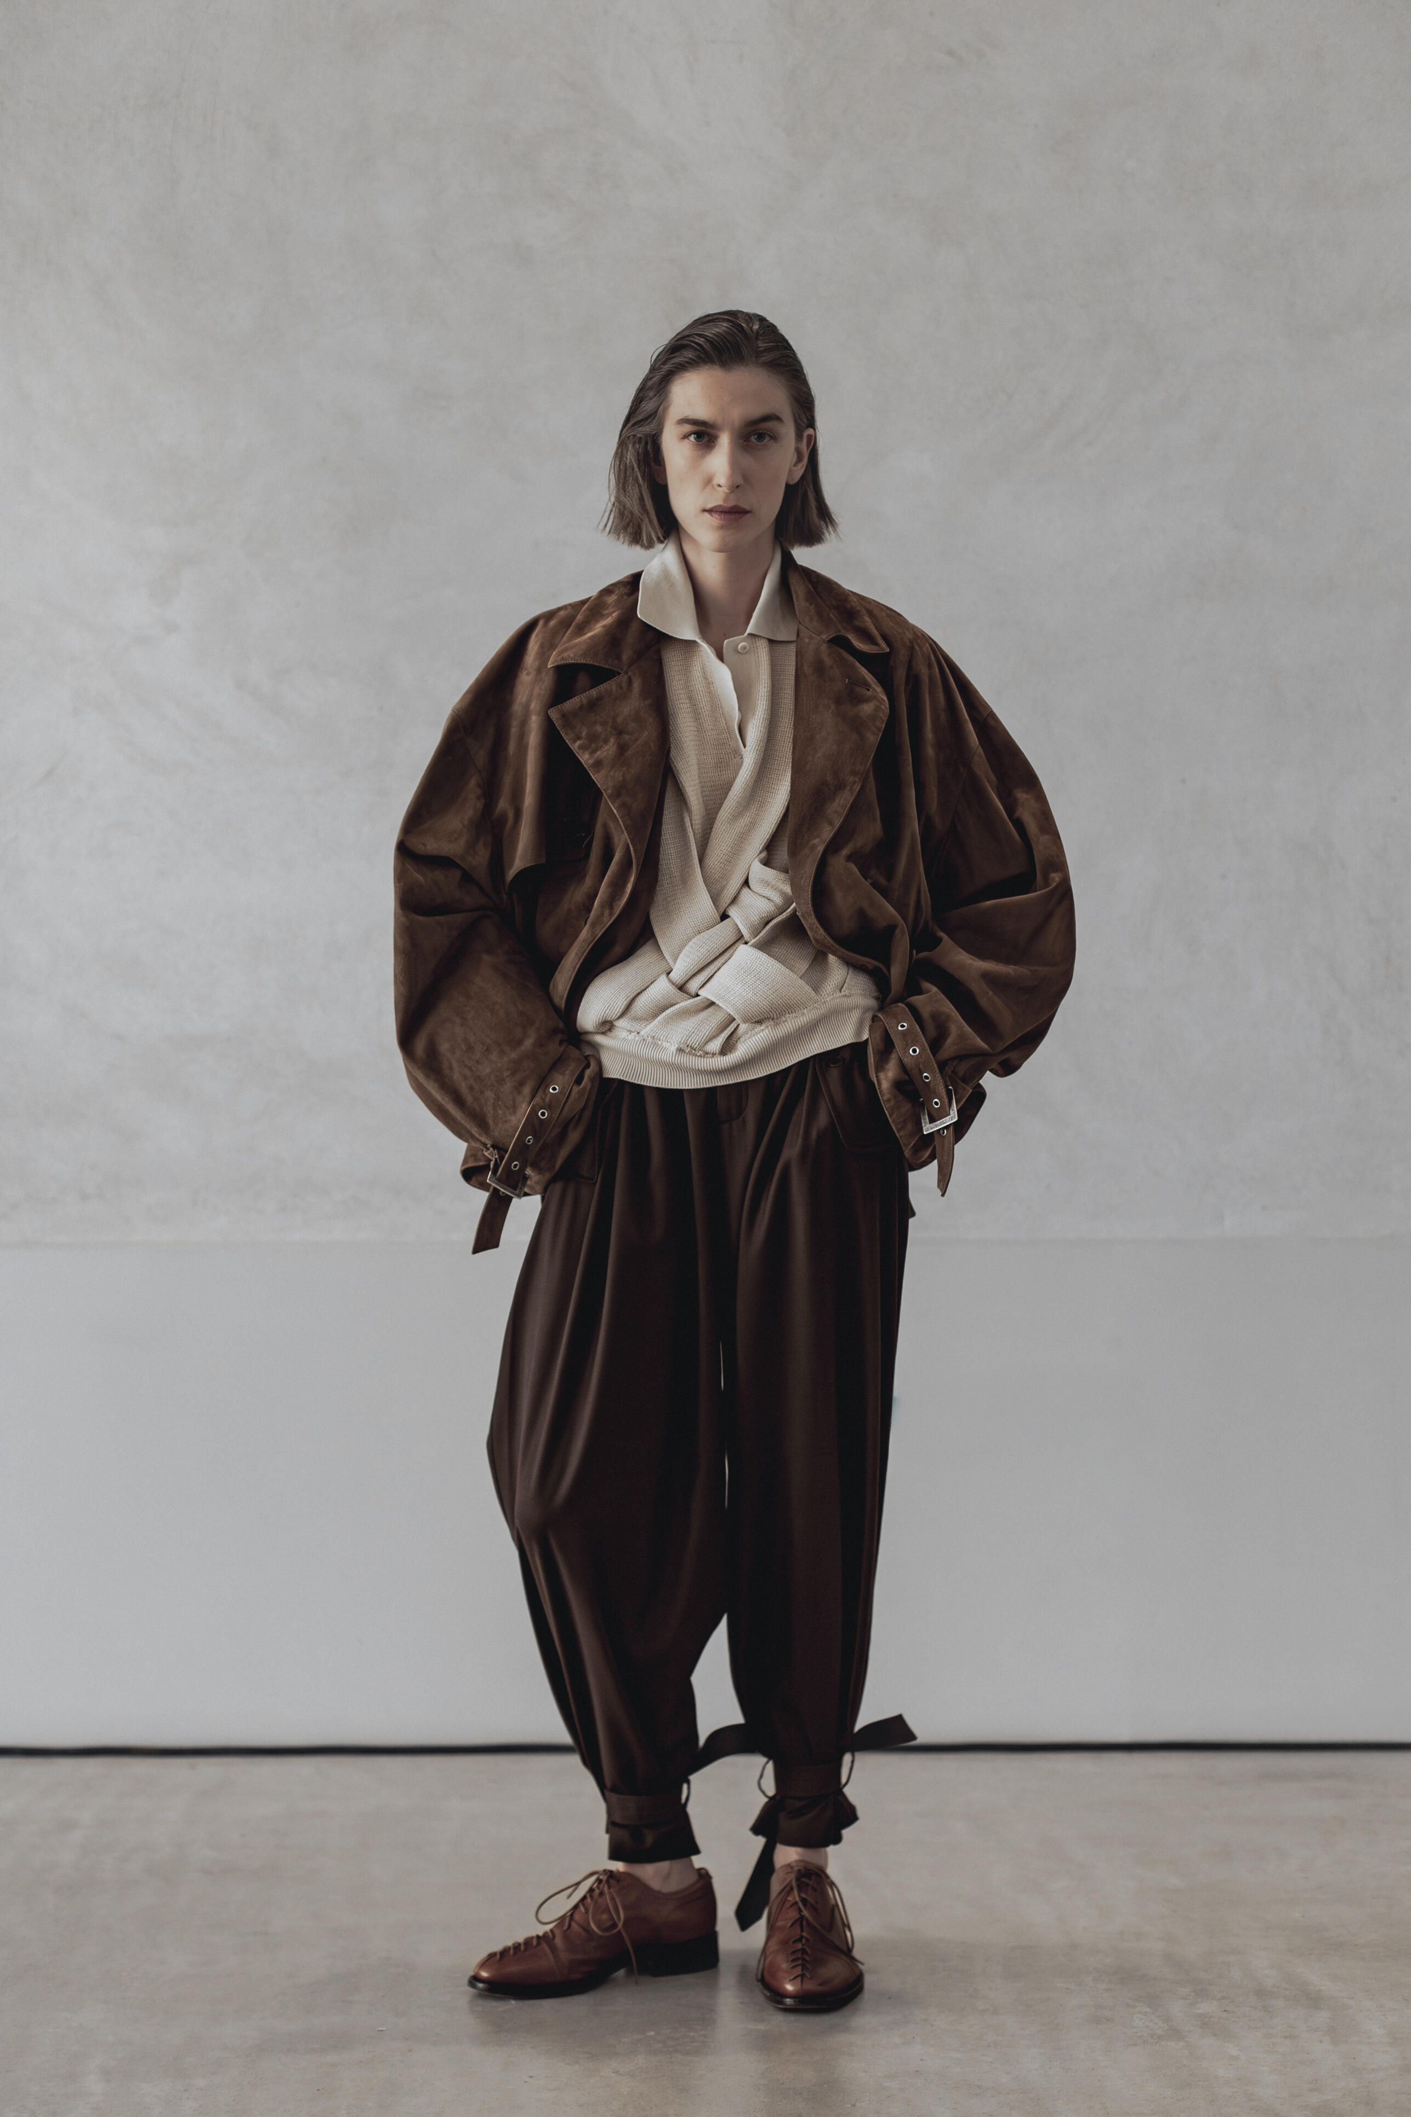
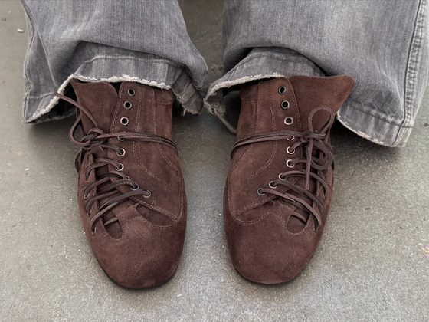
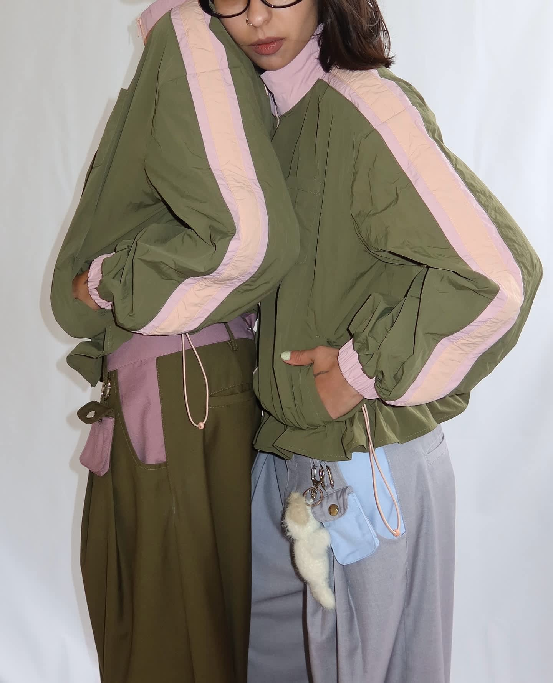
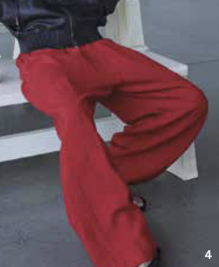
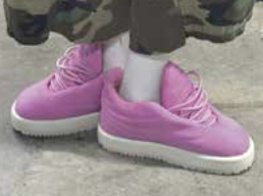
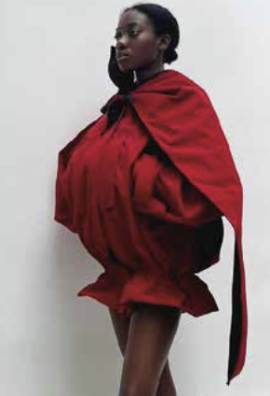
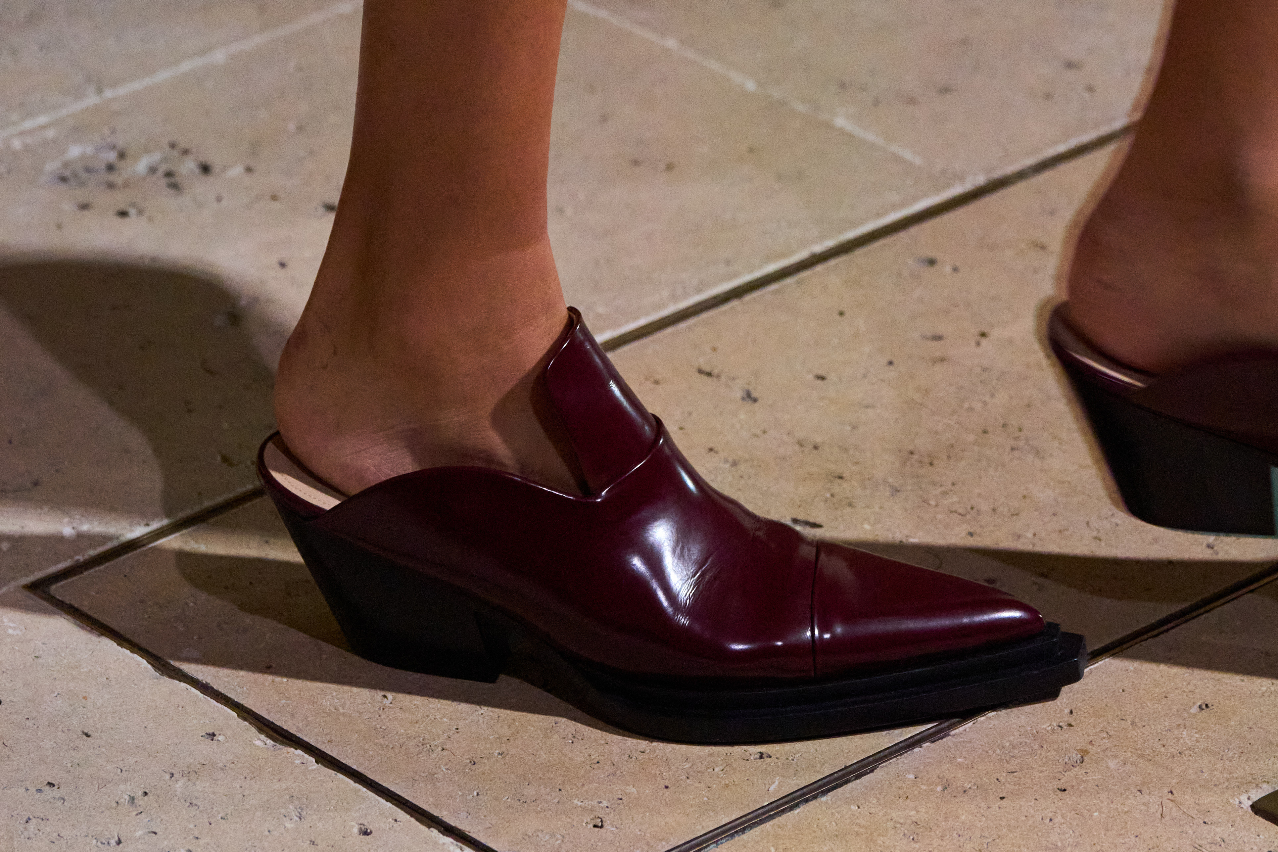
"Elle Effect” Colors In Action
Hanna
Future Snoops, Brand Unknown, FW26/27
Future Snoops, Mountain Research (Brand), FW26/27
Future Snoops, @Toomuchmariana (Instagram), FW26/27
Future Snoops, No Faith (Brand), FW26/27
Future Snoops, 4th and Recklace, FW26/27
Peclers Plus, Christian Dior, FW26/27
WGSN, Vautrait, FW26/27
WGSN, Brand Unknown, FW26/27
WGSN, Victoria Beckham, FW26/27
Peclers Plus, Brand Unknown, FW26/27
Peclers Plus,Verconiik, FW26/27
Peclers Plus, Brand Unknown, FW26/27

Slide 7
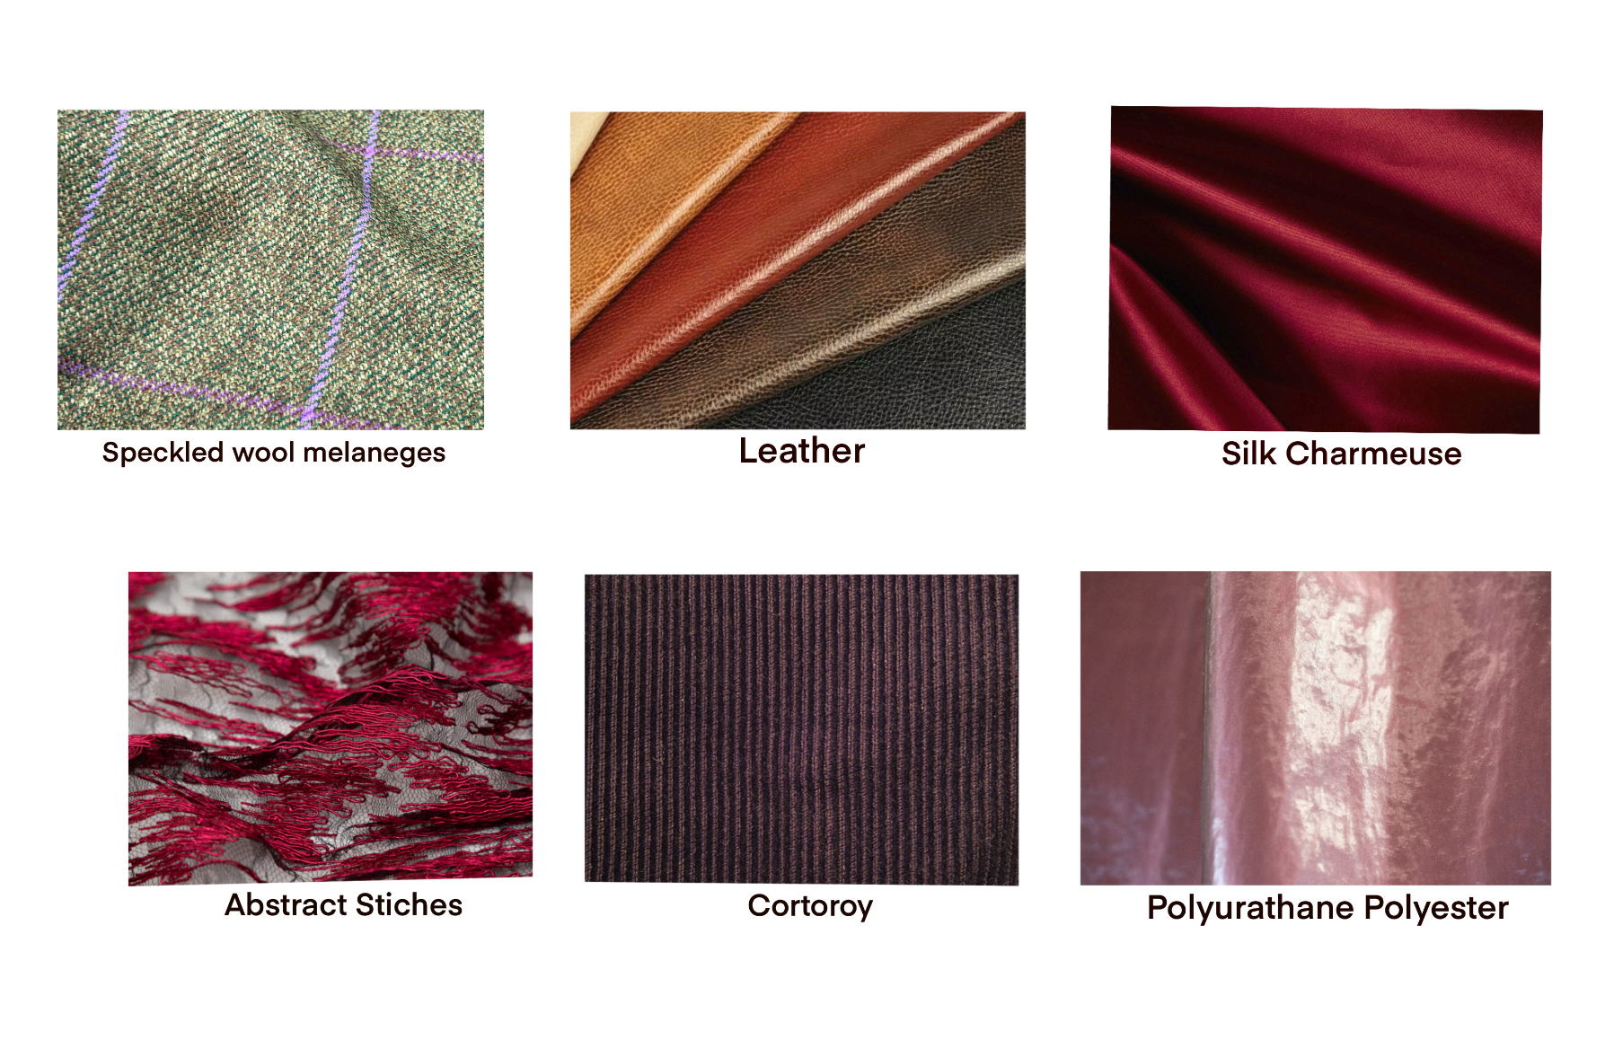
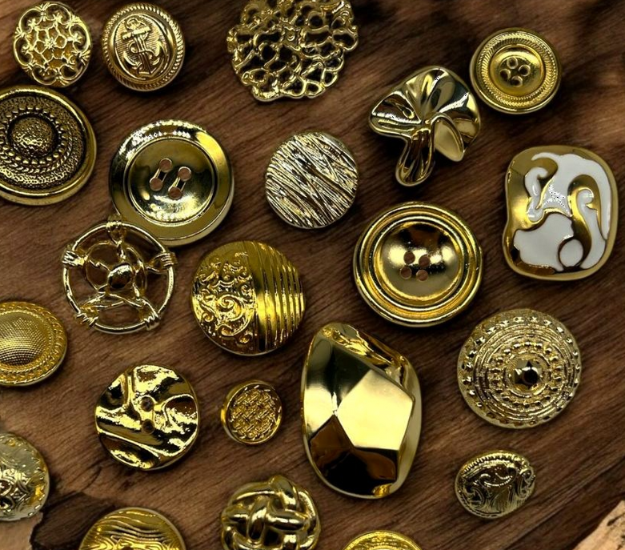
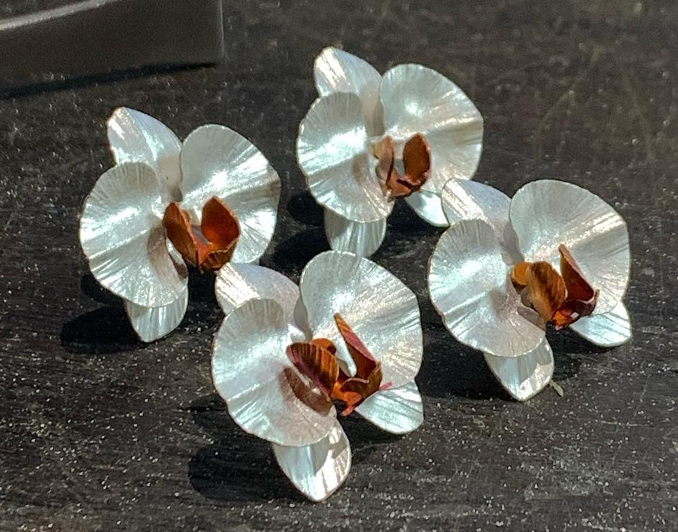
"Elle Effect” in Textiles and Trims for FW26
Konstantina & Hanna
Trims
WGSN. FW 26: Clubhouse Comforts [Trend forecast]. https://www.wgsn.com/fashion/article/68908d238c364a6826246c18#page3
ORNAMENTAL DIE-CAST BRASS
WGSN. (October 25). FW 26:[Trend report]. https://www.wgsn.com/fashion/article/68908d238c364a6826246c18#page5
Future Snoops. . FW 25/26: Citizens of Humanity [Trend report]. https://my.futuresnoops.com/explore/report/women/retail/fw-25-26/citizens-of-humanity/4776_62915_118_0
Future Snoops. FW 26: Trims [Trend report]. https://my-futuresnoops-com.libproxy.fitsuny.edu/explore/report/fw-26-27/trims/0_0_124_4721/
MOLDED TRANSLUCENT BOTANICALS
Future Snoops. (n.d.). FW 26: Lace & Mesh [Trend report]. https://my-futuresnoops-com.libproxy.fitsuny.edu/explore/report/fw-26-27/lace-mesh/0_0_124_4727/
WGSN. (October 25). FW 26:[Trend report]. https://www.wgsn.com/fashion/article/68908d238c364a6826246c18#page5
WGSN. (Oct. 15, 2025). (Concordia Textiles) Leather & Non-Leather Sourcing Guide A/W 26/27, https://www.wgsn.com/fashion/article/68908d238c364a6826246c18#page3
Future Snoops. FW 26: Trims [Trend report]. https://my-futuresnoops-com.libproxy.fitsuny.edu/explore/report/fw-26-27/trims/0_0_124_4721/
The “Elle Effect” theme is an interplay of sexiness and sophistication. It conveys a look that feels serious and rich, yet balanced with a touch of fun and allure. The palette and trims enhance this contrast, blending modern confidence with timeless elegance. Together, they create a mood that feels both powerful and effortlessly feminine.

Slide 8
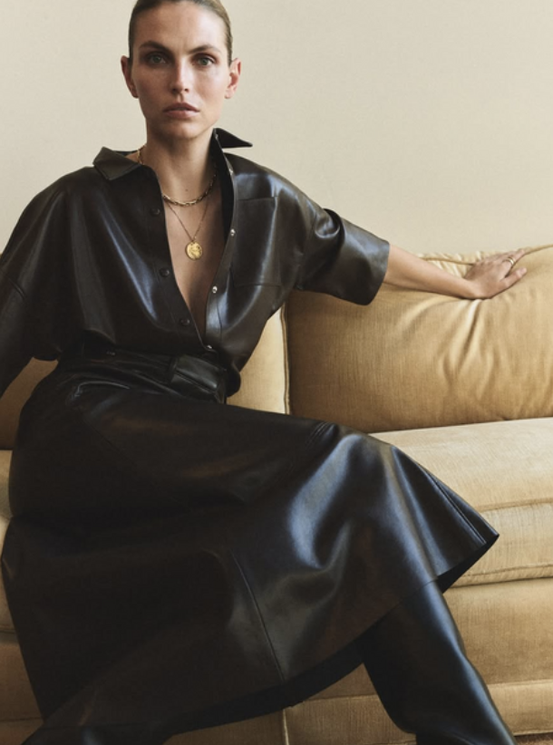
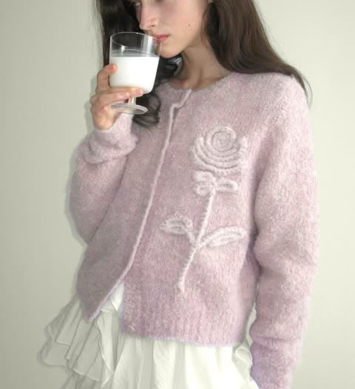
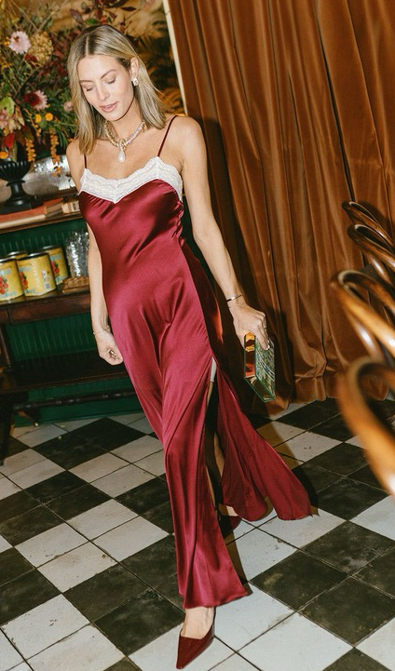
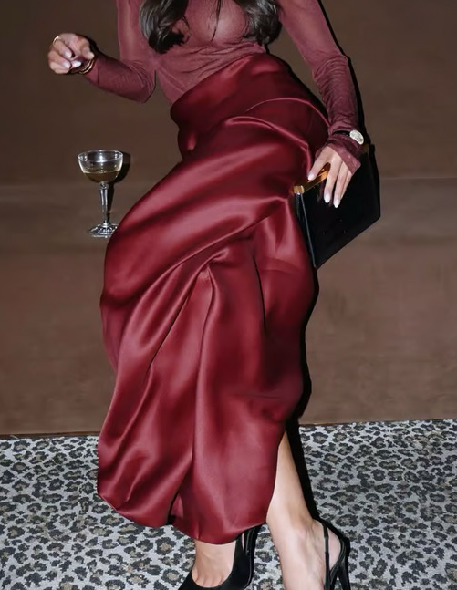
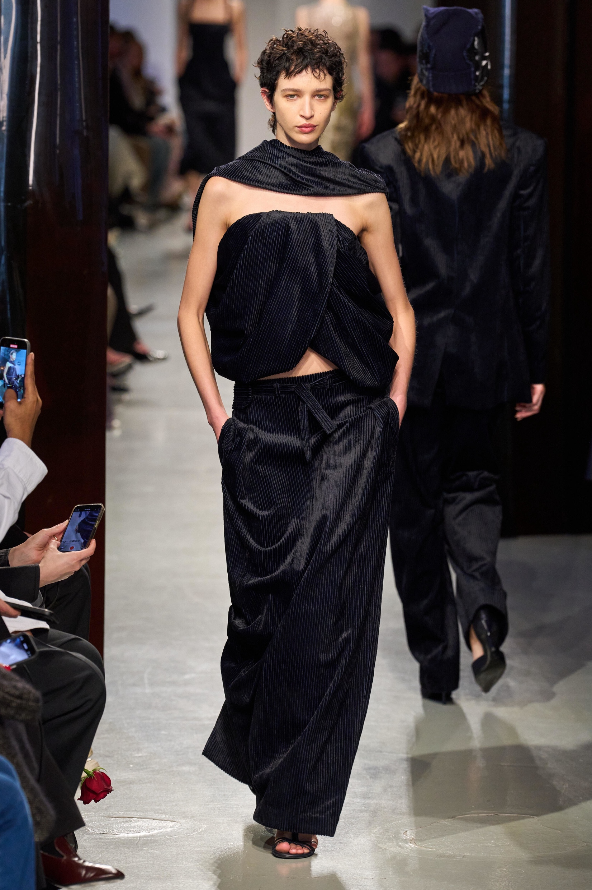
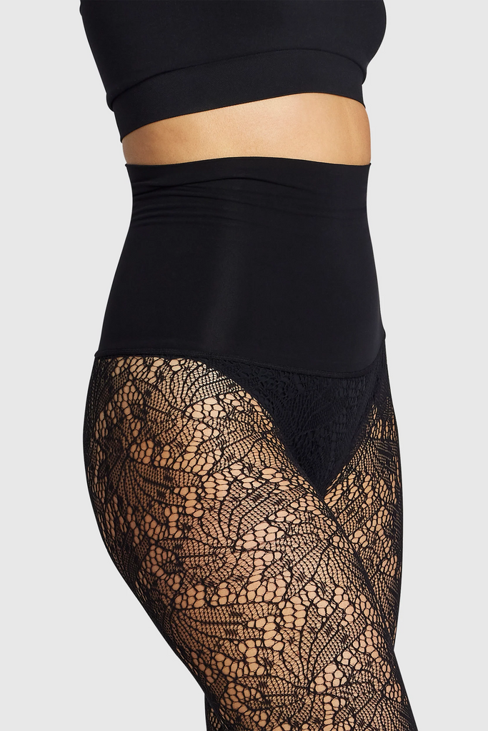
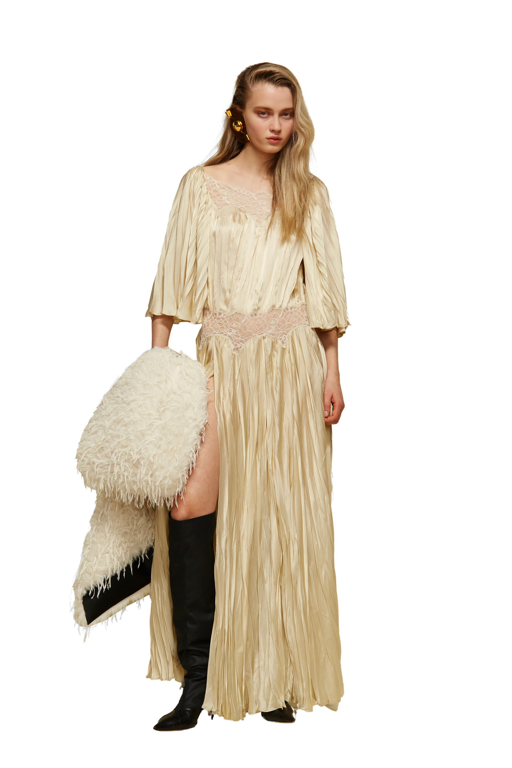
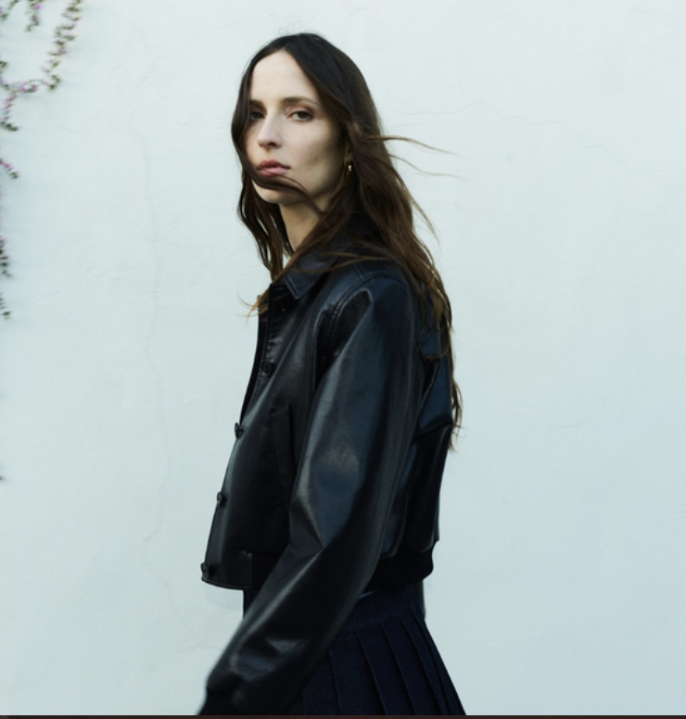
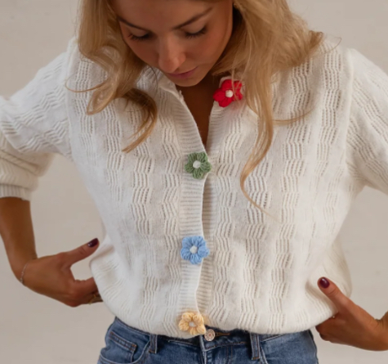
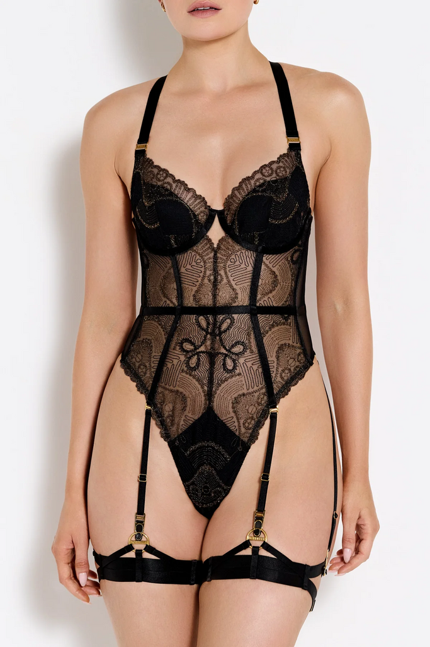
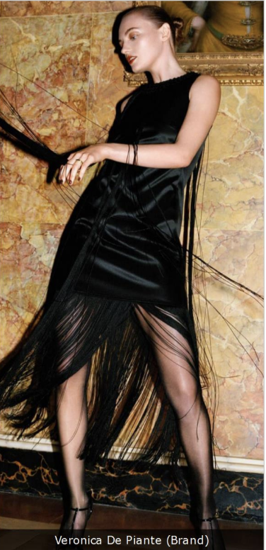
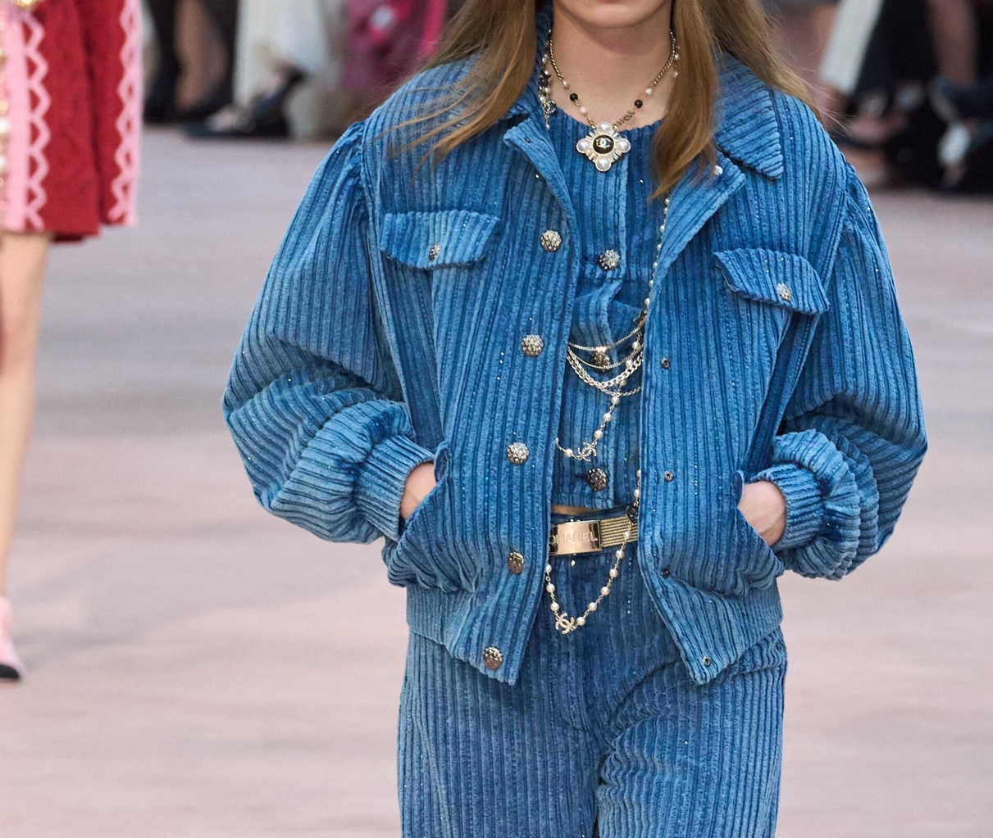
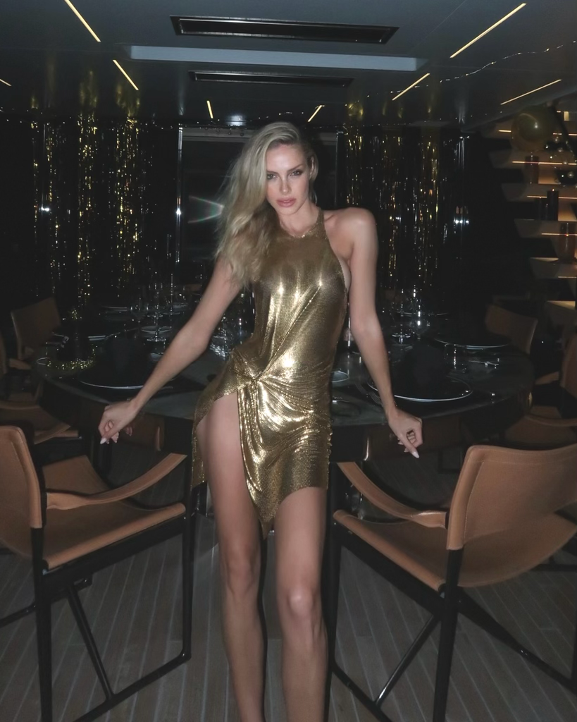
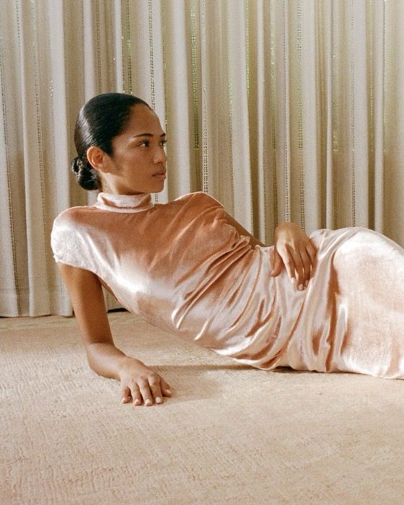
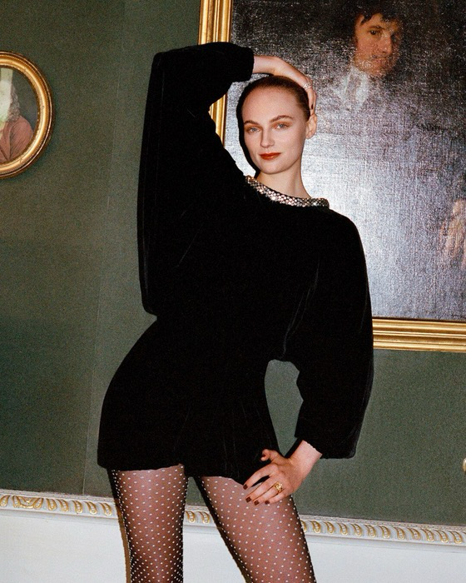
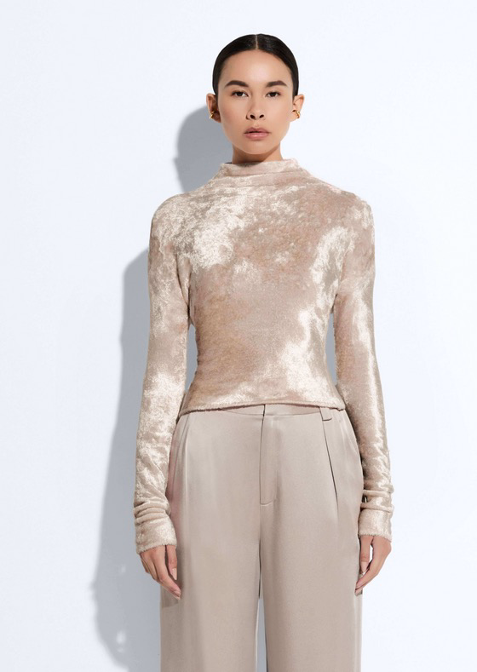
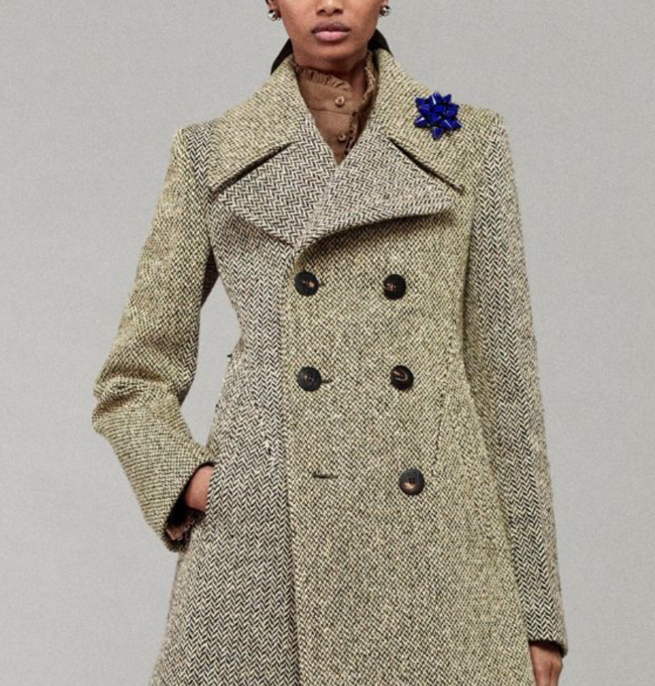
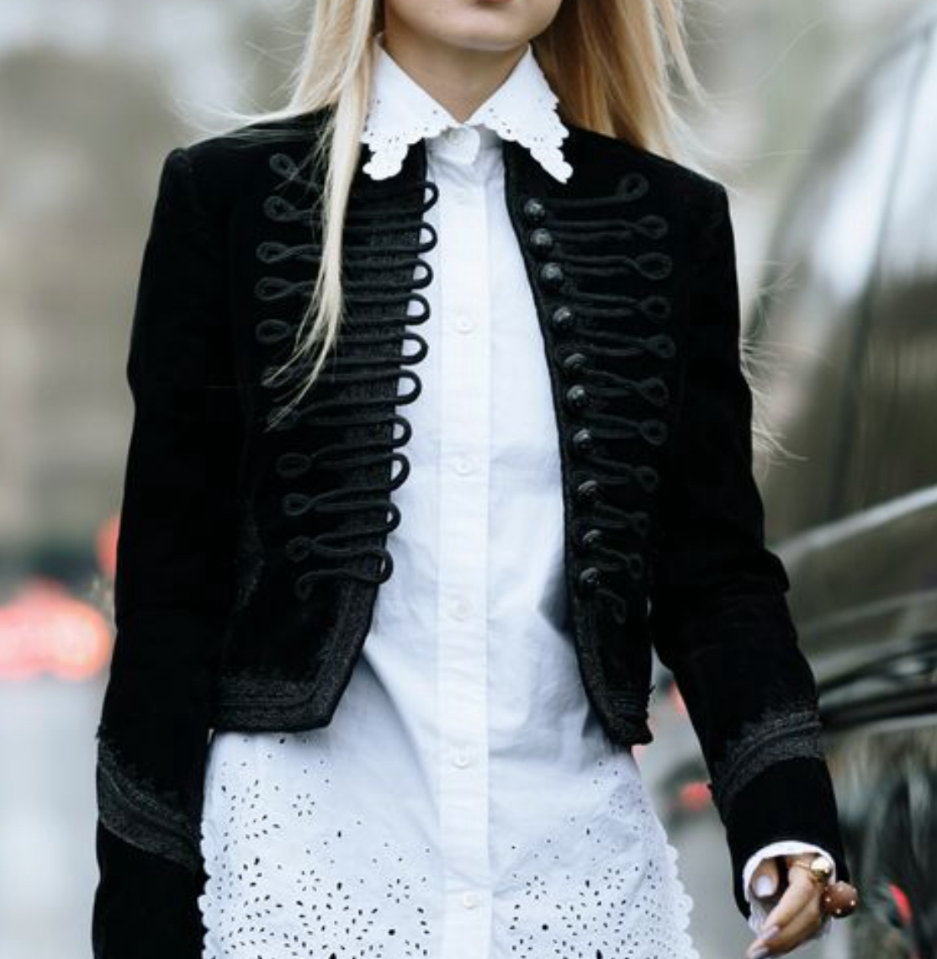
Peclers, Brand Unknown (FW6)
“The Era Of Intentional Femininity” In Textiles
Konstantina & Hanna
Future Snoops, Heist (FW 26)
WGSN, Christopher Esber (FW26)
Future Snoops, Sinoon (FW26)
Peclers, Veronica Di Piante (FW 26)
Peclers, Khaite (FW26)
WGSN, Chanel (FW26)
Future Snoops, Rochas (FW26)
Peclers, Brand Unknown (FW6)
Future Snoops, Bordelle (FW 26)
Future Snoops, @annamariaolbrycht (Influencer) (FW26)
Future Snoops, Lapointe (FW26)
Future Snoops, Staud (FW26))
Future Snoops, Balmain (FW26)
Peclers, Net A Porter (FW26)
WGSN, Burberry (FW26)

Slide 9
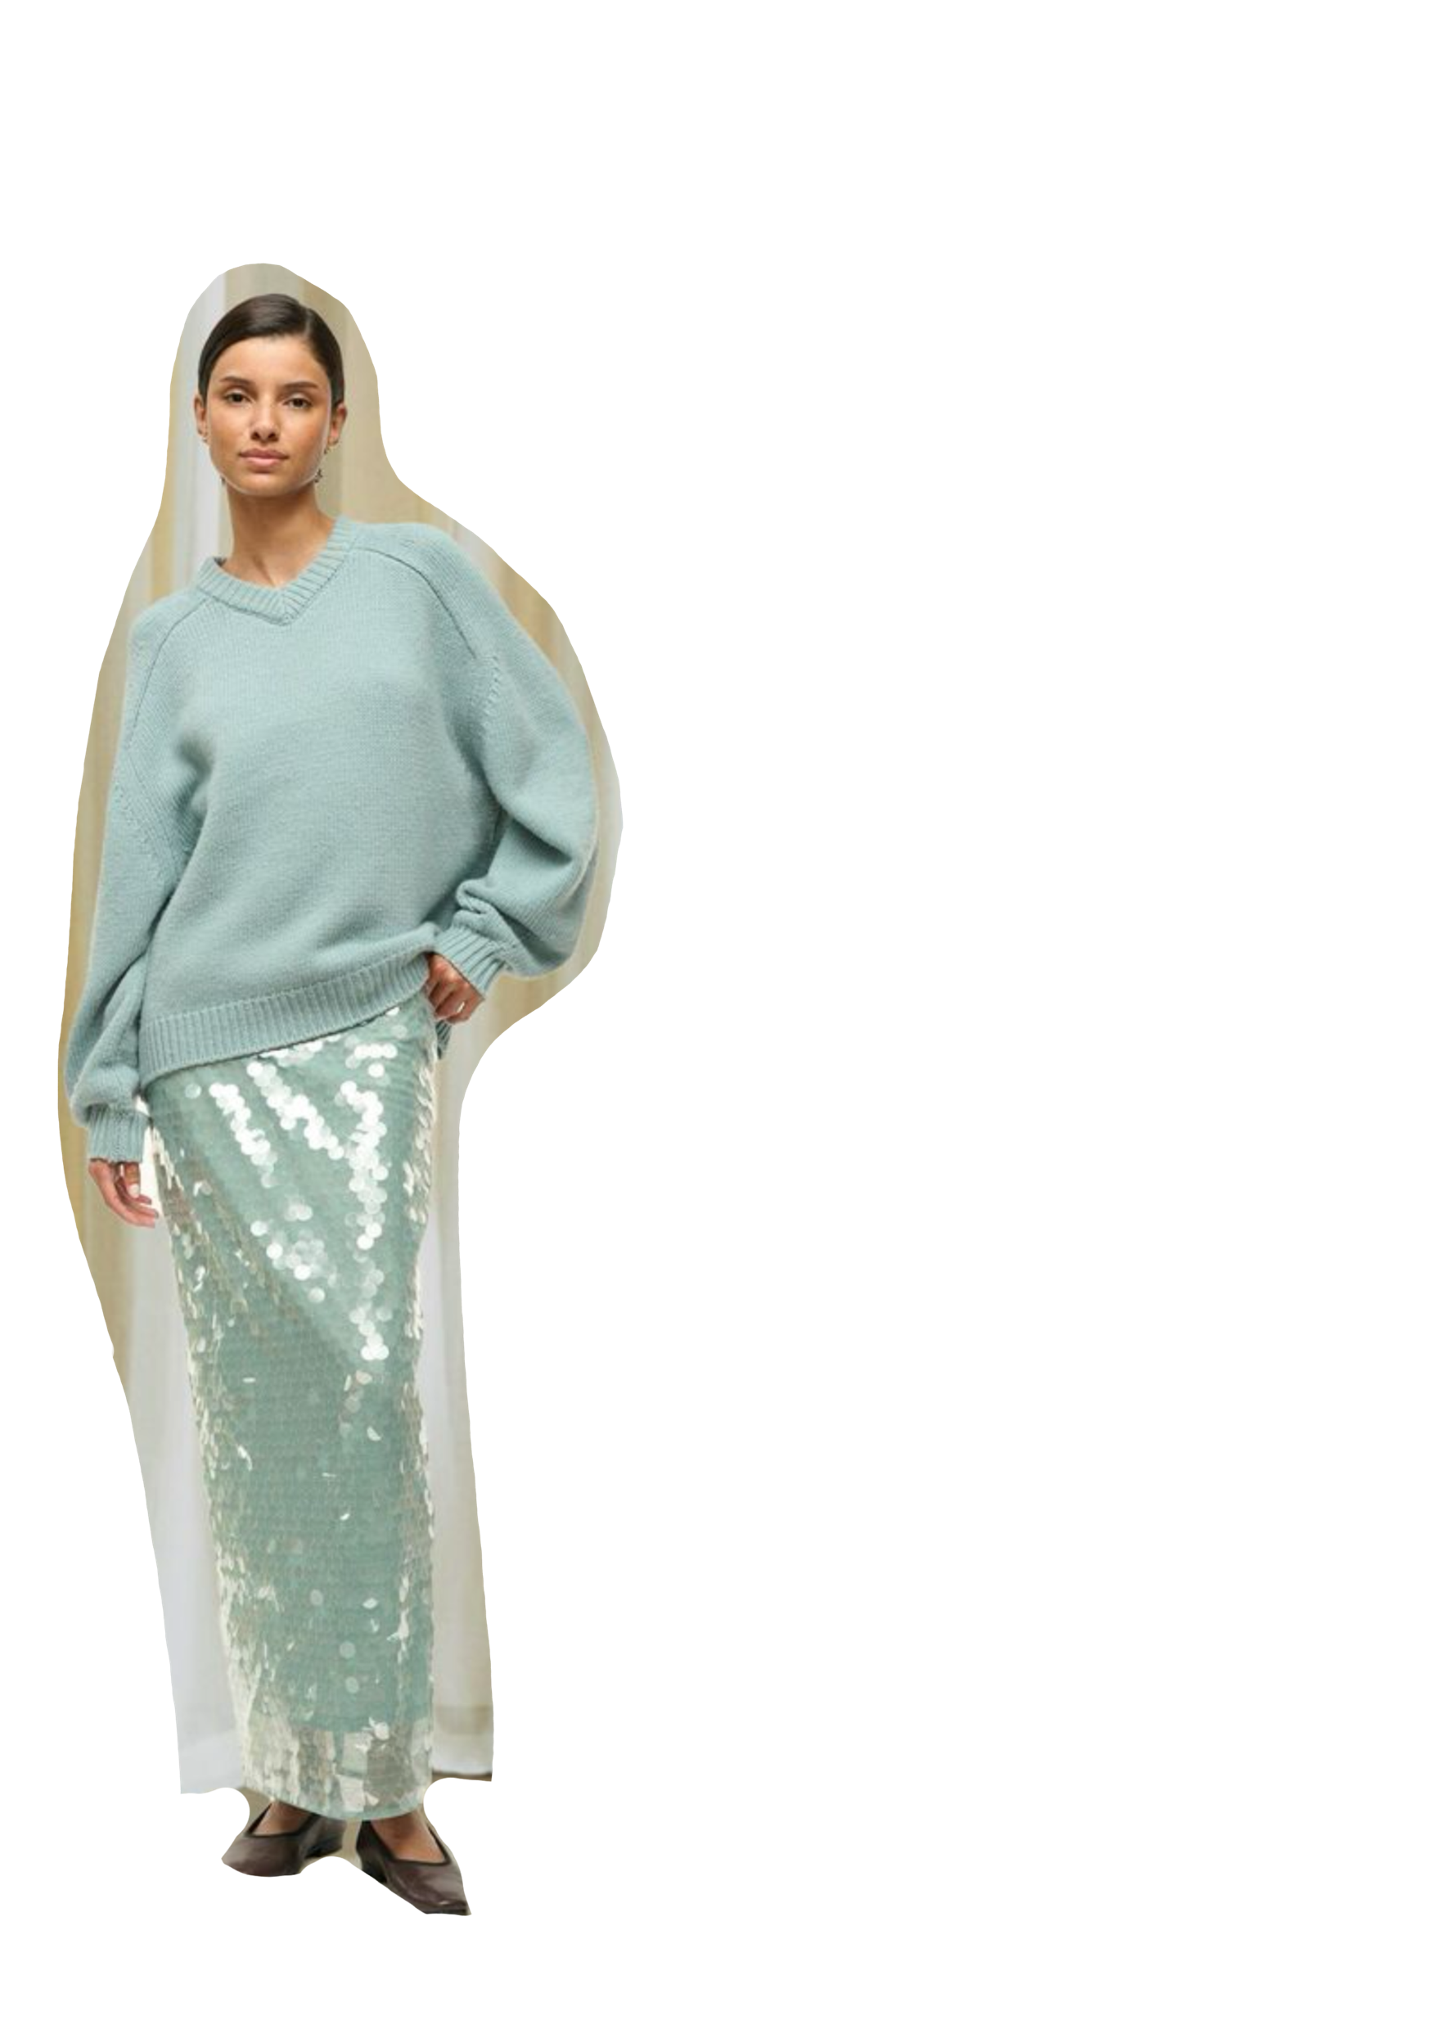
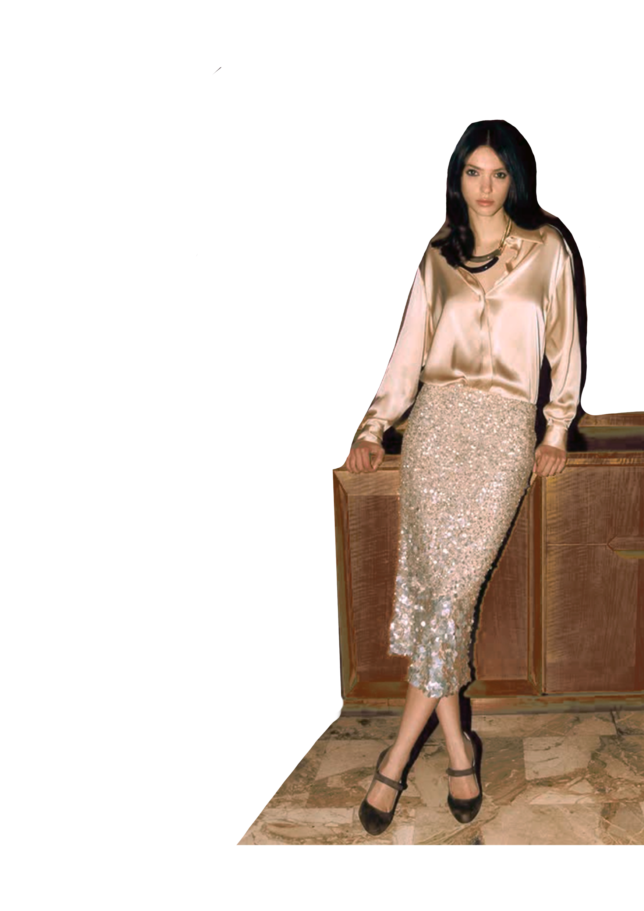
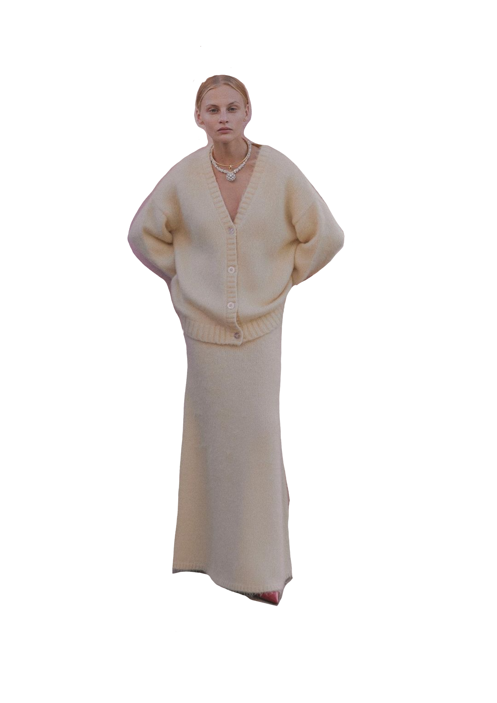


The "Elle Effect” Look
Konstantina
The Fluid Column Silhouette
Future Snoops, Choux, FW 26
Future Snoops, Staud, FW26
Future Snoops, Luisa Spagnoli, FW 26

Slide 10


The "Elle Effect” Look
Konstantina
Seductive lace structure
WSGN, Unknown Brand, FW26
WSGN, Dolce and Gabbana, SS 26
WSGN, Trussardi, FW26

Slide 11






The "Elle Effect” Look: Sculpted Softness
Hanna
Peclers, Emilia Wickstead (FW25/26)
WGSN, Givenchy (FW25/26)
Future Snoops, Chanel (FW25/26)
Future Snoops, Alaia (FW25/26)
Peclers, MSGM (FW25/26)
Future Snoops, Sinead Gorey (FW25/26)
Notes:
https://www.peclersplus.com/runway-shows/211/17/728

Slide 12







Konstantina & Hanna
The "Elle Effect” in interior design
WGSN, Brand Unknown, FW26/27
Future Snoops, Inedito (FW25/26)
Where Soft Glam Meets Everyday Objects
Future Snoops, Inedito (FW25/26)
Fashion Snoops,G.56 Hub Creativo (FW25/26)
Future Snoops, Tucas Home, FW26
WGSN, Brand Unknown, FW26/27
WGSN, H&M home, FW26

Slide 13

The Era of Intentional Femininity – Summary Prediction
The “Elle effect” FW26 color palette blends grounded sophistication with intentional femininity, moving from deep espresso browns and refined grays to energized pinks, corals, reds, and plums that symbolize ambition, intellect, and self-assured elegance. Together, these shades reimagine the Elle Woods era for a modern feminist future, balancing power and playfulness, academic prestige and personal expression, all through a lens of confident, evolved femininity.
The textiles and trims for FW26 reinterpret femininity through a balance of richness, sensuality, and modern polishmixing cozy wool melanges, sleek leather, lustrous charmeuse, and dimensional lace with sculptural brass and translucent botanical details. Together, these materials create a mood that feels intelligent, luxurious, and intentionally feminine, blending seriousness with playful allure to echo the evolved Elle Woods attitude of confidence and elegance.
The FW26 “Elle effect” looks blend elongated, fluid silhouettes with soft sculpting and subtle lace structure, creating a balance of strength, sensuality, and intelligence. Each look expresses intentional femininit, enhancing confidence, grace, and modern empowerment through movement, texture, and refined romantic detailing.

Slide 14
References
Fritton, N (September 19, 2025). 10 Spring 2026 fashion trends that stood out on the New York runways. Harper’s Bazaar. https://www.harpersbazaar.com/fashion/a67963156/spring-2026-runway-fashion-trends/
Future Snoops. (September 16, 2025). SS 26: Soft Romance [Trend report overview]. https://my.futuresnoops.com/explore/report/ss-26/soft-romance/0_0_119_5779
Future Snoops. (October 9, 2025). SS 26: Blush Pink [Trend report overview]. https://my.futuresnoops.com/explore/report/ss-26/blush-pink/0_0_119_5995
Future Snoops. (2025, October 14). Runway – SS 26: Bags [Trend report]. https://my.futuresnoops.com/explore/report/accessories/runway/ss-26/bags/0_0_119_6006
Future Snoops. (2025, October 16). Runway – SS 26: Footwear [Trend report]. https://my.futuresnoops.com/explore/report/accessories/runway/ss-26/footwear/0_0_119_6019
Salibian, S. (2025, October 14). Top accessories from the Spring 2026 fashion weeks: Buyers weigh in on shoes and bags. Women’s Wear Daily. https://wwd.com/accessories-news/accessory-trends/top-accessories-spring-2026-fashion-weeks-buyers-shoes-bags-1238300324/
Chanel, (n.d). Chanel Website. https://www.chanel.com/us/fragrance/p/113530/coco-eau-de-parfum-spray/
Dior, Dior Website. https://www.dior.com/en_us/beauty/fragrance/womens-fragrance/miss-dior
Future Snoops. (September 25). FW 26/27: Mudberry – Mudberry Color Pelette [Trend report]. https://my-futuresnoops-com.libproxy.fitsuny.edu/explore/report/fw-27-28/mudberry/0_0_130_5750 (Colors: Sage statement, Trench Coat Beige, Fashion School Lipstick)
Future Snoops. FW 26: Color Shifts — Superimposed Pastels Palette [Trend report]. https://my-futuresnoops-com.libproxy.fitsuny.edu/explore/report/fw-25-26/color-shifts/6238_61641_118_0(Colors: Empowerment Plum, Mocha Mindset, and Law Firm Gray)
Future Snoops. (Oct. 23, 2025). FW 26/27 Clubhouse Comforts [Trend Forecast] https://my.futuresnoops.com/explore/report/fw-26-27/clubhouse-comforts/0_0_124_6043
Future Snoops. (Oct. 17, 2025). FW 26/27, Design Aesthetic Forge [Trend Forecast] https://my.futuresnoops.com/explore/report/fw-27-28/forge/0_0_130_6027
Peclers. (Date Unknown) FW 26/27, Inspirations Envisioning Futures https://www.peclersplus.com/trend-book/745/viewer
WGSN. Fall/Winter Color Forecast. 2026 – Lunar Holiday Palette. https://www.wgsn.com/interiors/article/68d898b5d556203cc36dadea#page3 (Elle Woods Pink, Bruiser Woods Mauve, Louboutin Stiletto Red, The New Harvard Color)
WSGN. (Oct. 15, 2025) FW 26/27. Buyers’ Briefing: Women’s Colour A/W 26/27. https://www.wgsn.com/fashion/article/68dcfed2953b11bc8edc51b1#page13
WSGN. (Oct. 15, 2025) FW 26/27. Buying Directors Briefing: Women’s Key Items A/W 26/27 https://www.wgsn.com/fashion/article/68cd6d8bd556203cc35c46e7

